Slide 1
bookly
final presentation
Notes:
Alexandra: Vorstellung,Vision

Slide 2

Outline
Use Cases
Demo
Project Management
Architecture
Quality
Notes:
Alexandra
Vision+Agenda (Intro): 2min
Use Cases: 3min
Demo: 3,5min
PM: 3,5-4min
Architecture: 4-4,5min
Quality: 2,5-3min
Further Questions + Documentation: 30s

Slide 3
Use Cases
Notes:
Alex

Slide 4
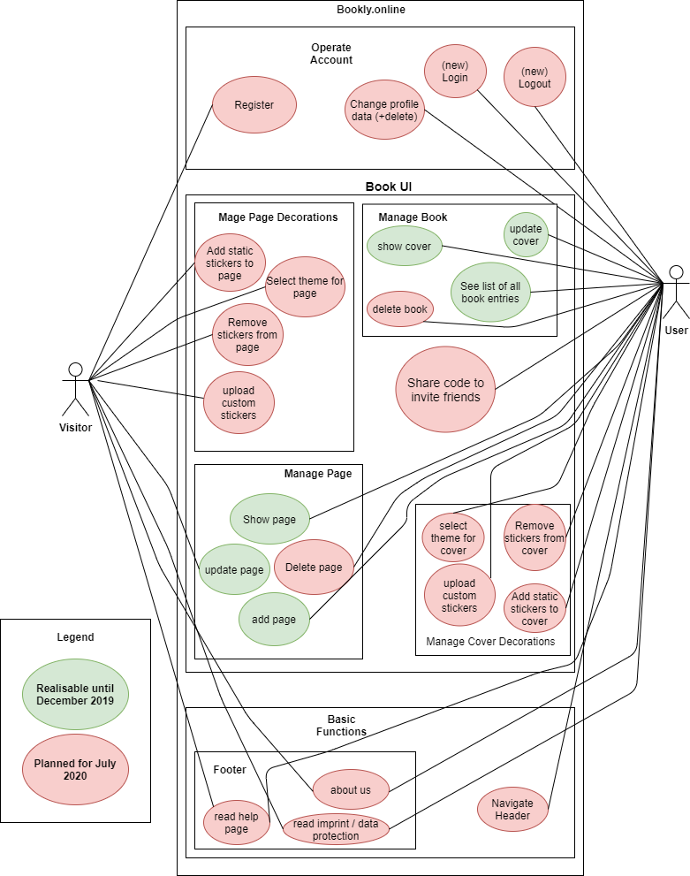
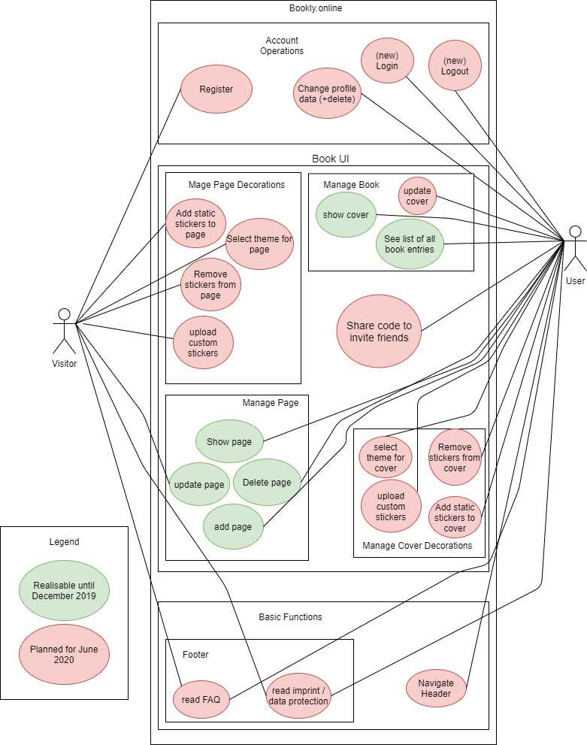
Extend of functionality
Notes:
2min - Jeanne: Derived from our vision you can see an overview of our use cases here. We have divided them into a required implementation for 2019 (green) and 2020 (red). At first you will see some minor minor functions: Account Operations and basic functions like the footer or the header.

Slide 5
Extend of functionality
Notes:
Jeanne: the main part of our funcionality is the book ui. We have a book that belongs to a user and some pages that can be filled out by any friend.
We divided the book ui into Manage book and Manage Page. Those were CRUDs but as this is the main functionality of our app we split them up into separate use cases and specified them on their own. A Page and a book can be designed by adding an image or a sticker too.

Slide 6
Use Cases
Manage page
C: create page entry (UC 1)
R: read an entry (UC 2)
U: update/edit an entry (UC 3)
D: delete an entry (part of account)
Manage book
C: create a book (UC 4)
R: show cover/title (UC 5)
U: update cover/title (UC 6)
D: delete (part of account)
Green implemented in 2019
Red implemented in 2020
Bold Use Case
Notes:
Jeanne: here you can see our numbered Use Cases that were implemented in 2019 (again green) and 2020 (red).
Further Information can be found in our SRS.

Slide 7
Use Cases
Share code to invite friends (UC 7)
Manage Page Decorations (UC 8)
C: create sticker
R: read sticker
U: update sticker
D: delete sticker
Navigate Footer (UC 10)
Navigate Header (UC 11)
Operate Account (UC 12)
Manage Cover Decorations (UC 9)
C: create sticker
R: read sticker/theme
U: update sticker/theme
D: delete sticker
Green implemented in 2019
Red implemented in 2020
Bold Use Case
Notes:
Jeanne: Überleitung zu Nico und Alfaview Sharing beenden

Slide 8
DEMO
► Video
BOOKLY - friendship book
Notes:
Nico: LIVE-Demo ~X min
- Startseite + Footer + Header + Help (erwähnen)
- Login
- Cover
- Edit Cover
- Profile + Add Page
- Edit Page
- Read Page
- Delete Page
- Logout
NICHT: Video anklicken, KEINE IDE, KEIN GITLAB, KEINE URL AUSSER bookly.online, KEINE EXCEL TABELLEN

Slide 9
Project Management
Notes:
Alexandra

Slide 10
RUP- Rational Unified Process
Alexandra
Requirements Specifier: Describe and phrase the features / design of the website with the team
Project Manager: Phrase acceptance criteria of the features + Coordinate sprints + Manage YouTrack + Assign Tags
Jeanne
Implementer: Create database structure, logic, and interfaces (API)
Tester: Test the interfaces (APIs) between Frontend, Backend, Database and the functionality of the Frontend
Nico
Deployer: Host domain and integrate CI (and Docker)
Designer: Implement the design described in the Use-Cases + Web tests
Notes:
Jeder erklärt selber!

Slide 11
RUP- Workflow

Slide 12
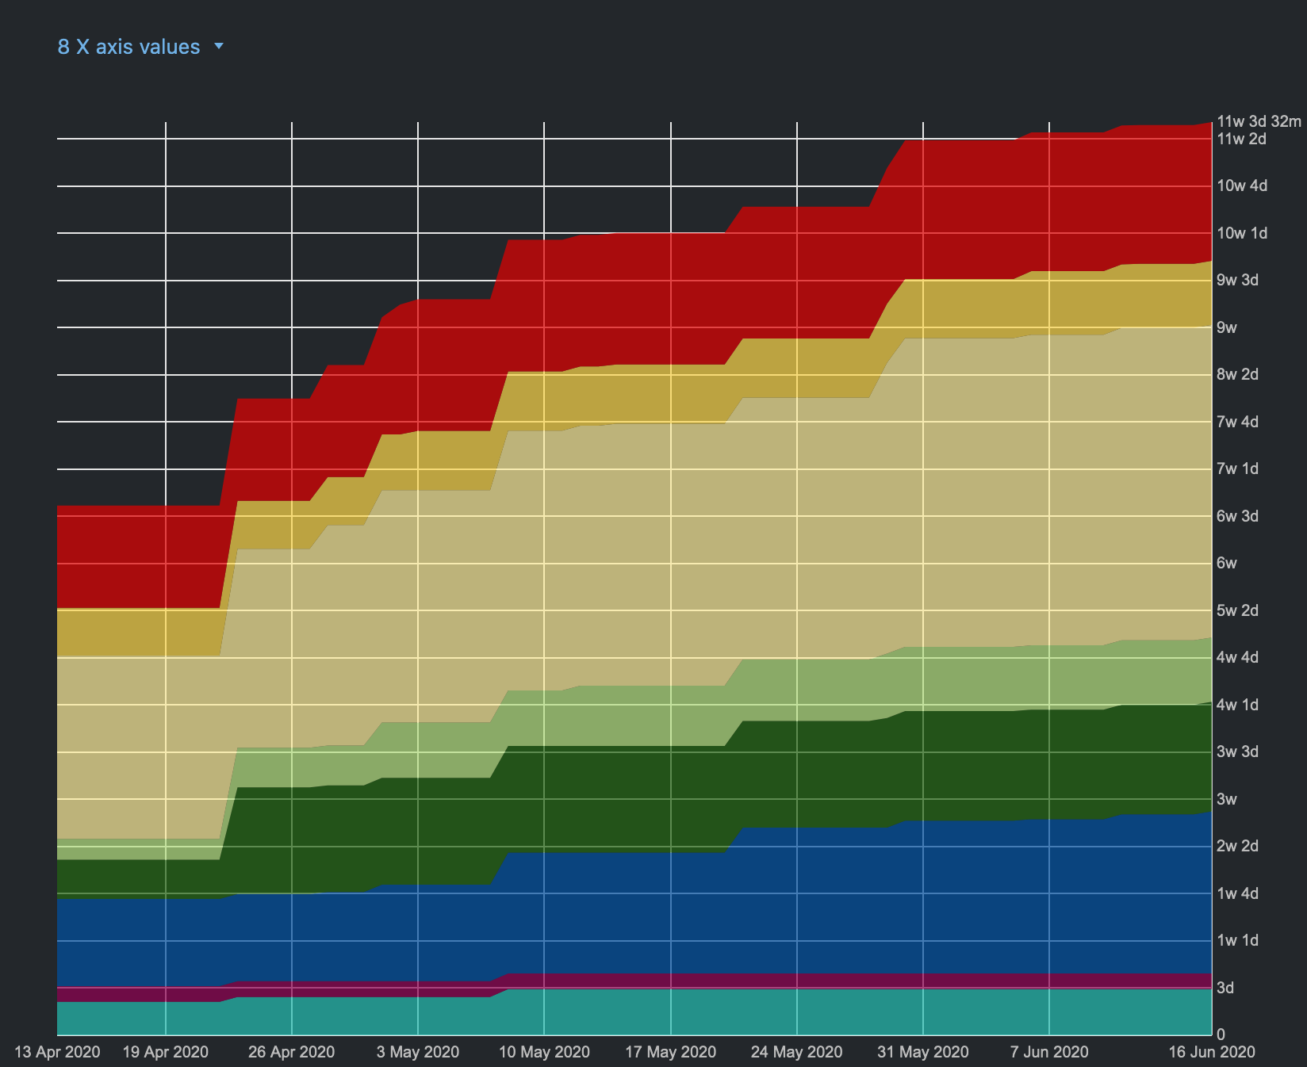
RUP- Workflow - 2020

Slide 13
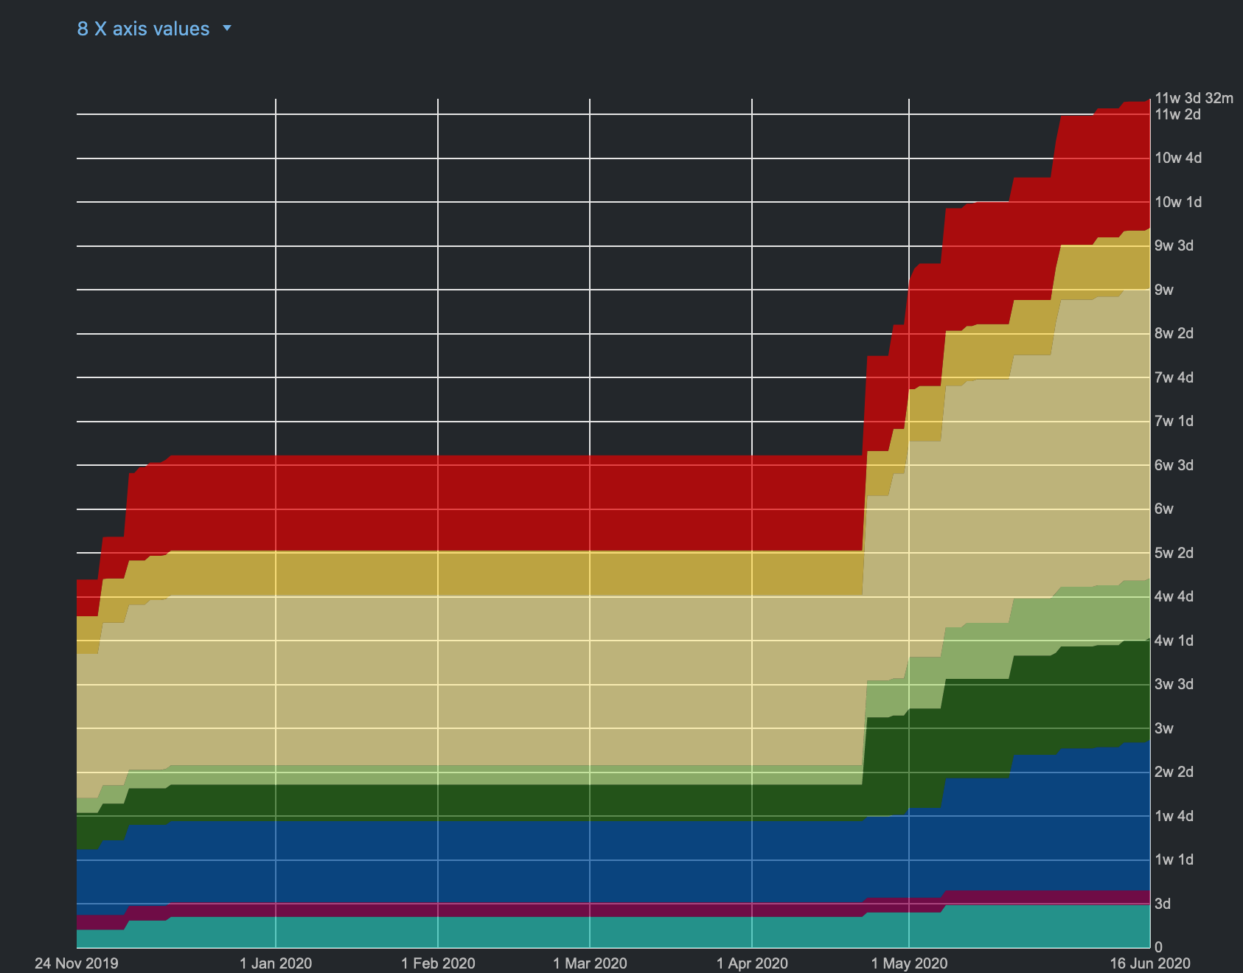
RUP- Workflow - complete
Notes:
Alex

Slide 14
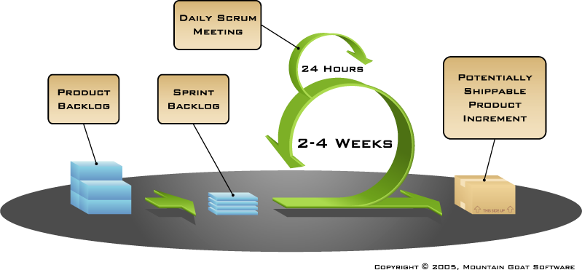
Scrum and Youtrack
weekly
Notes:
Jeanne: Youtrack integriert in IntelliJ als Plugin und in Git, 30s-1min
Scrum is a process model for project and product management, especially for agile software development. There is a backlog that lists all planned functionalities in order of priority. The customer decides in a fixed rhythm which next functions he would like to have implemented next. After consultation with the team, these functions are put into a sprint. A sprint has a fixed cycle in which these functions are to be implemented. At the end of a sprint, the results are presented to the customer. For us the duration is 2 weeks, i.e. every 2 weeks our product Bookly was extended with new functions and could be seen live. In addition, we have a fixed weekly appointment where we can discuss possible problems and obstacles and help each other.

Slide 15
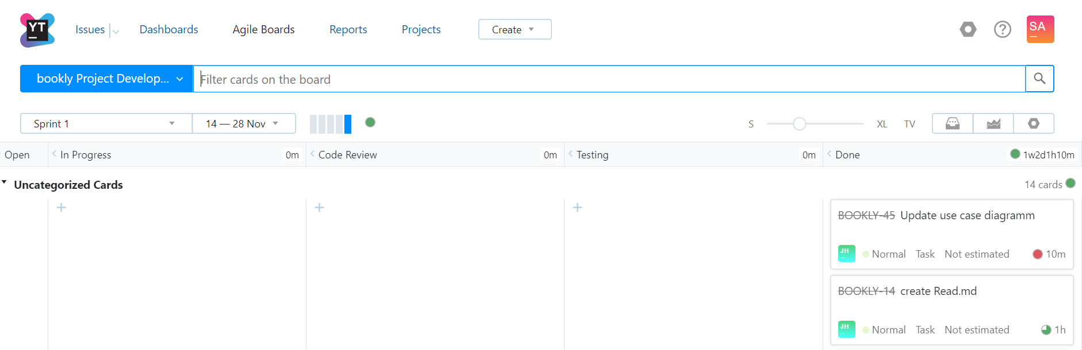
Scrum and Youtrack
Notes:
Jeanne: Here you can see our agile board YouTrack and an excerpt of functions we had in the sprint. The team can independently assign tasks from the sprint backlog, develop them, review, test and complete them. 30s

Slide 16
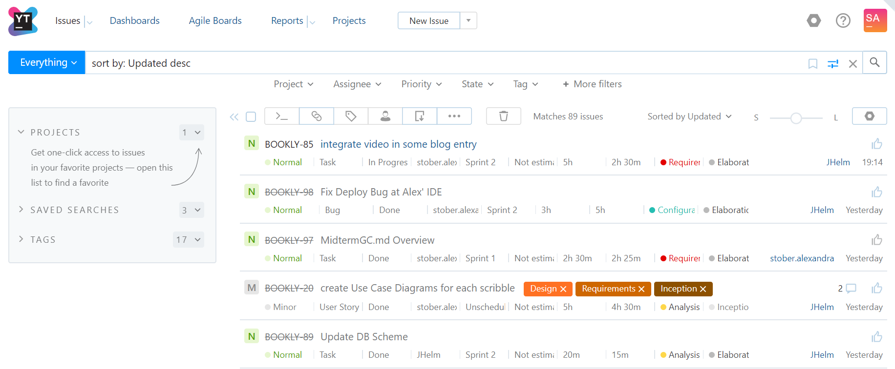
Scrum and Youtrack
Notes:
Jeanne: Here is an excerpt from our backlog with all (also completed) issues. Here you can also add new cards. A new issue must always be assigned an RUP phase (which we will discuss later) and an estimated time. 30s

Slide 17
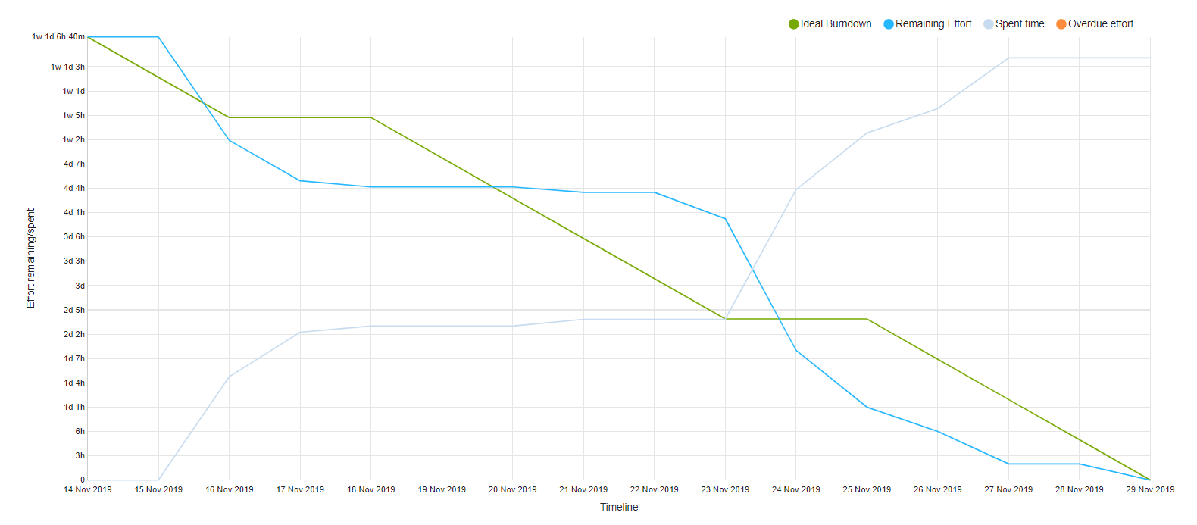
Burn-Down-Chart
► more
Notes:
Jeanne: 30s Here you can see one of our Burndown Charts. You can get an overview of all our sprints by clicking on the following link in the upper right corner. A burndown chart is a graphical representation of the remaining effort in a project, in relation to the remaining time. The optimal burn down from this ratio is highlighted in green. Grey is our current time needed for all completed features in the corresponding sprint, blue is our real burn down of this corresponding sprint.

Slide 18
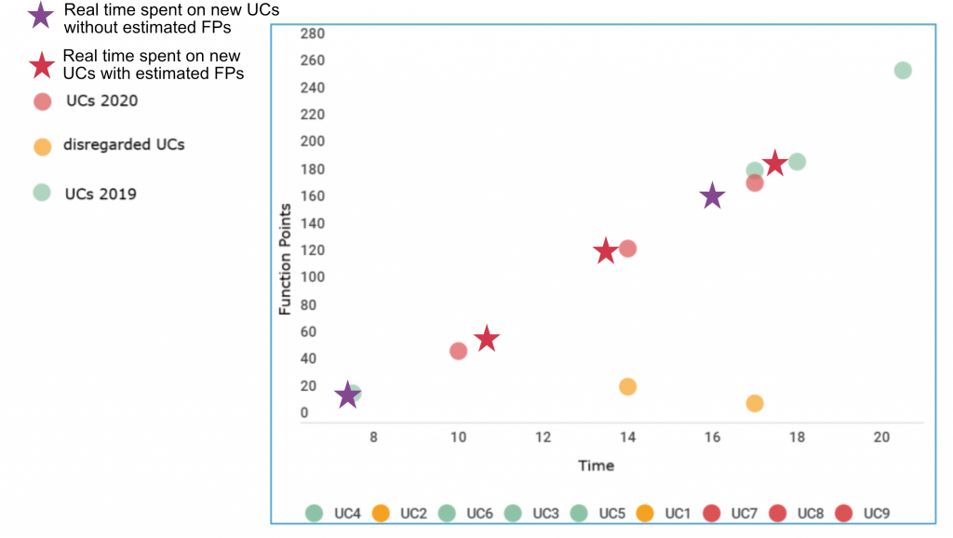
Cost Estimation
Notes:
Alex

Slide 19
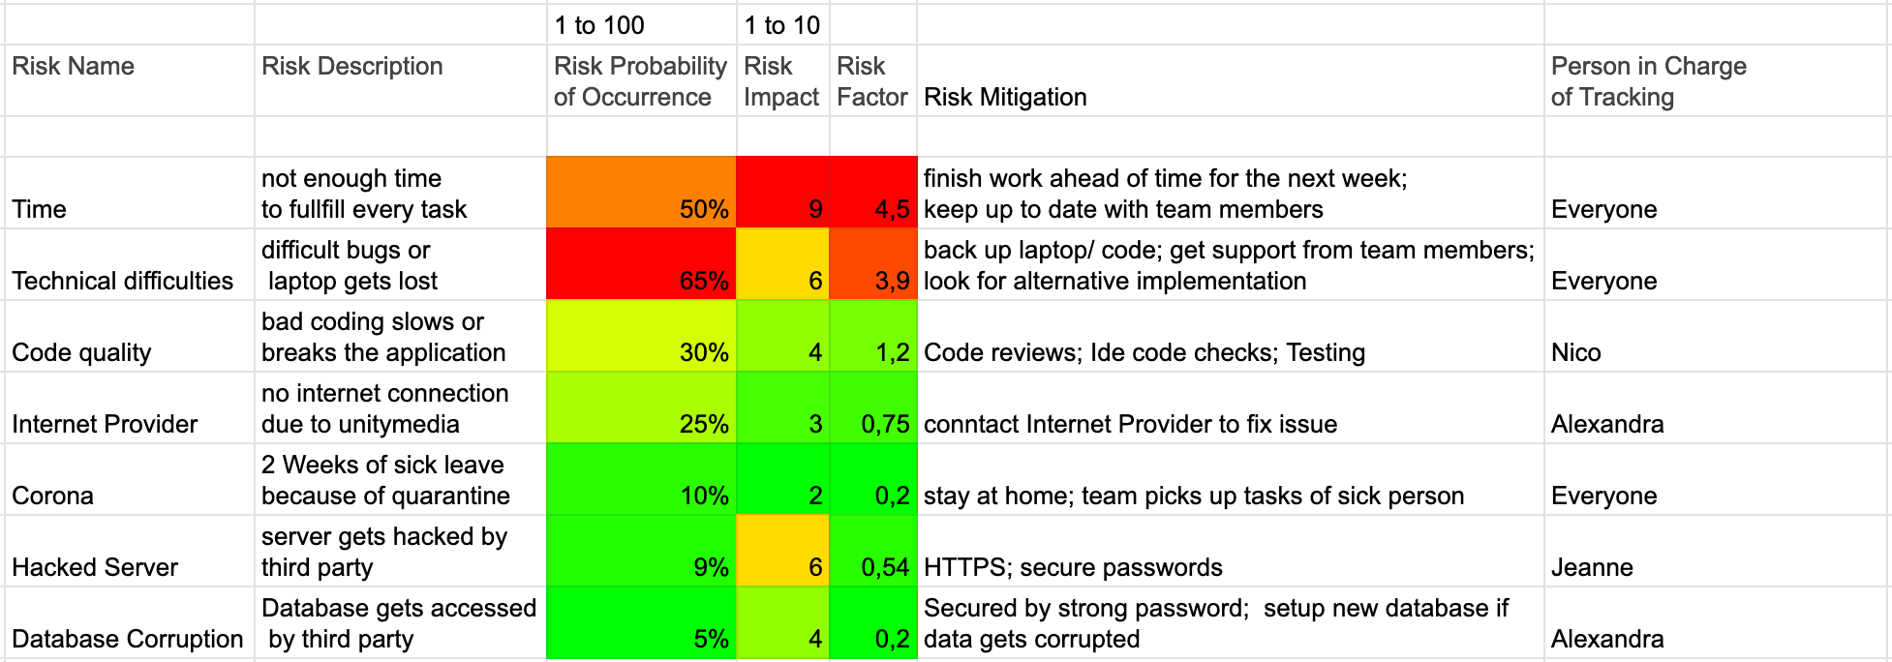
Risk Management
Risk Management ► here
Notes:
Alex

Slide 20
Architecture
Notes:
Alex

Slide 21

Main Idea

Slide 22
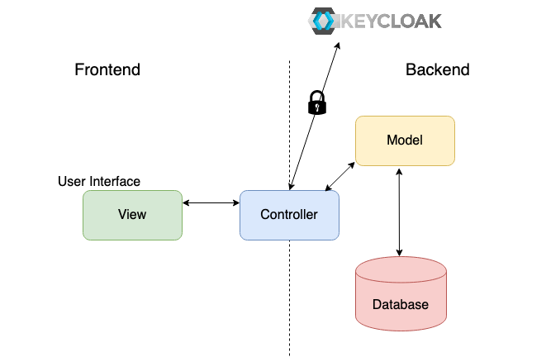
Overview
Notes:
Alex: further info can be found in SAD
Überleitung zu nächster Folie bei Database

Slide 23
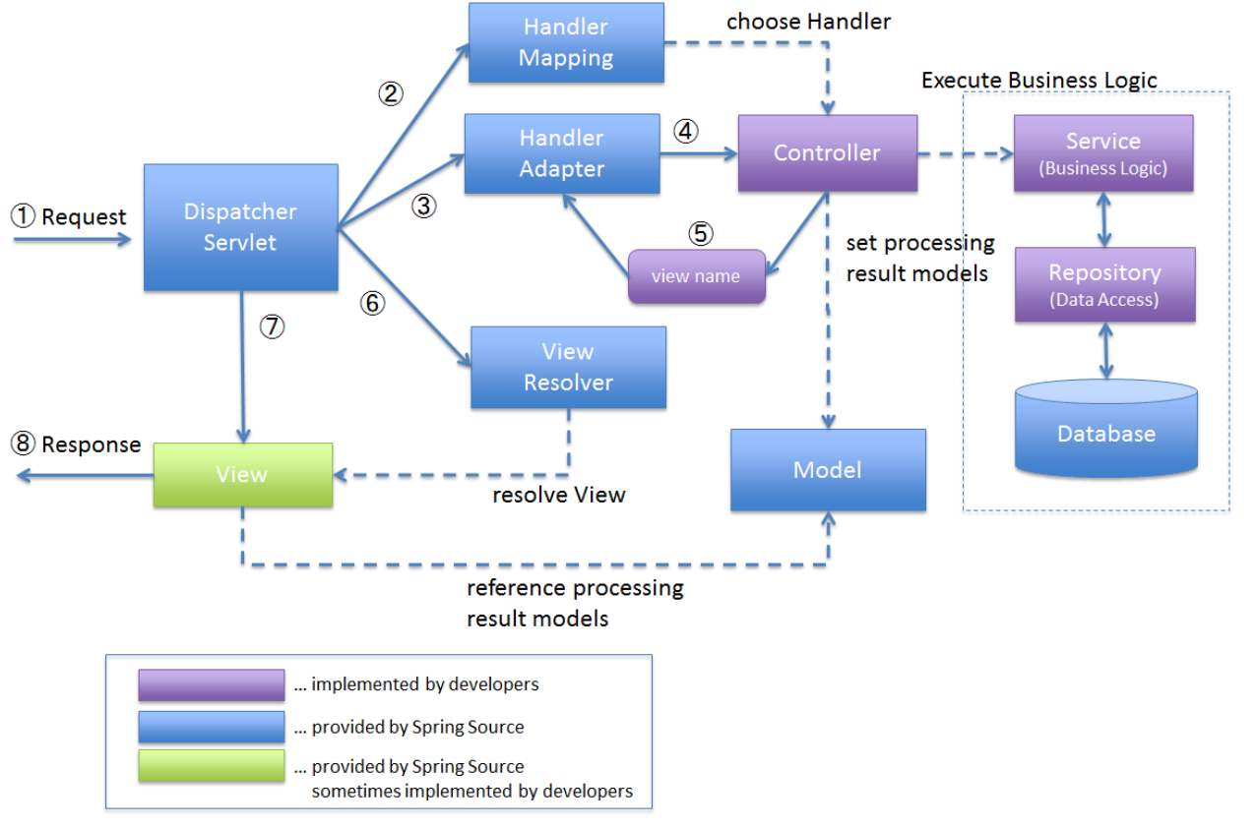
Architecture – Overview

Slide 24
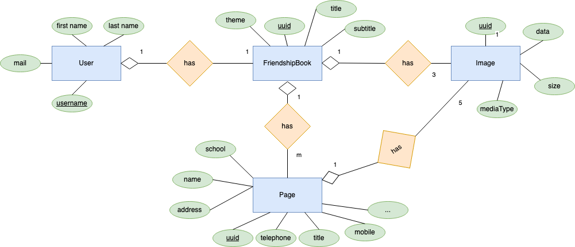
Database scheme – Data View
Notes:
Alex

Slide 25






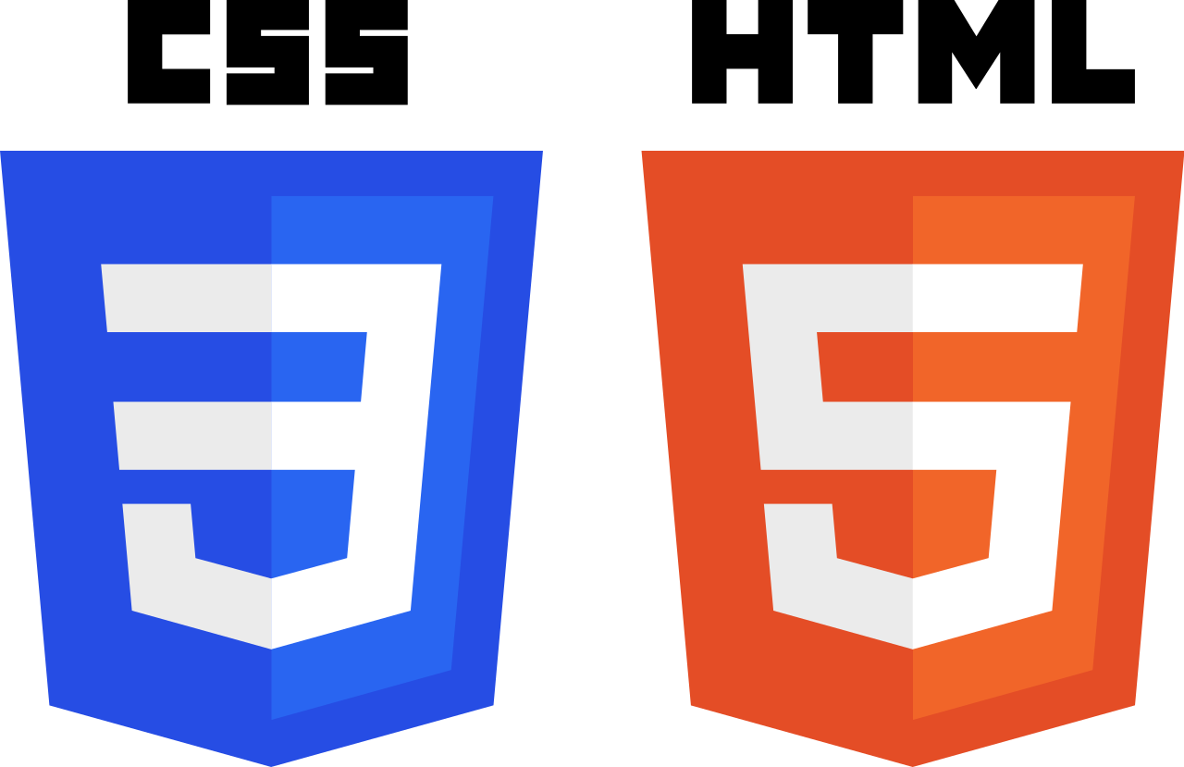










Technology
Backend
Frontend
Testing
Deployment
Notes:
Alex:

Slide 26
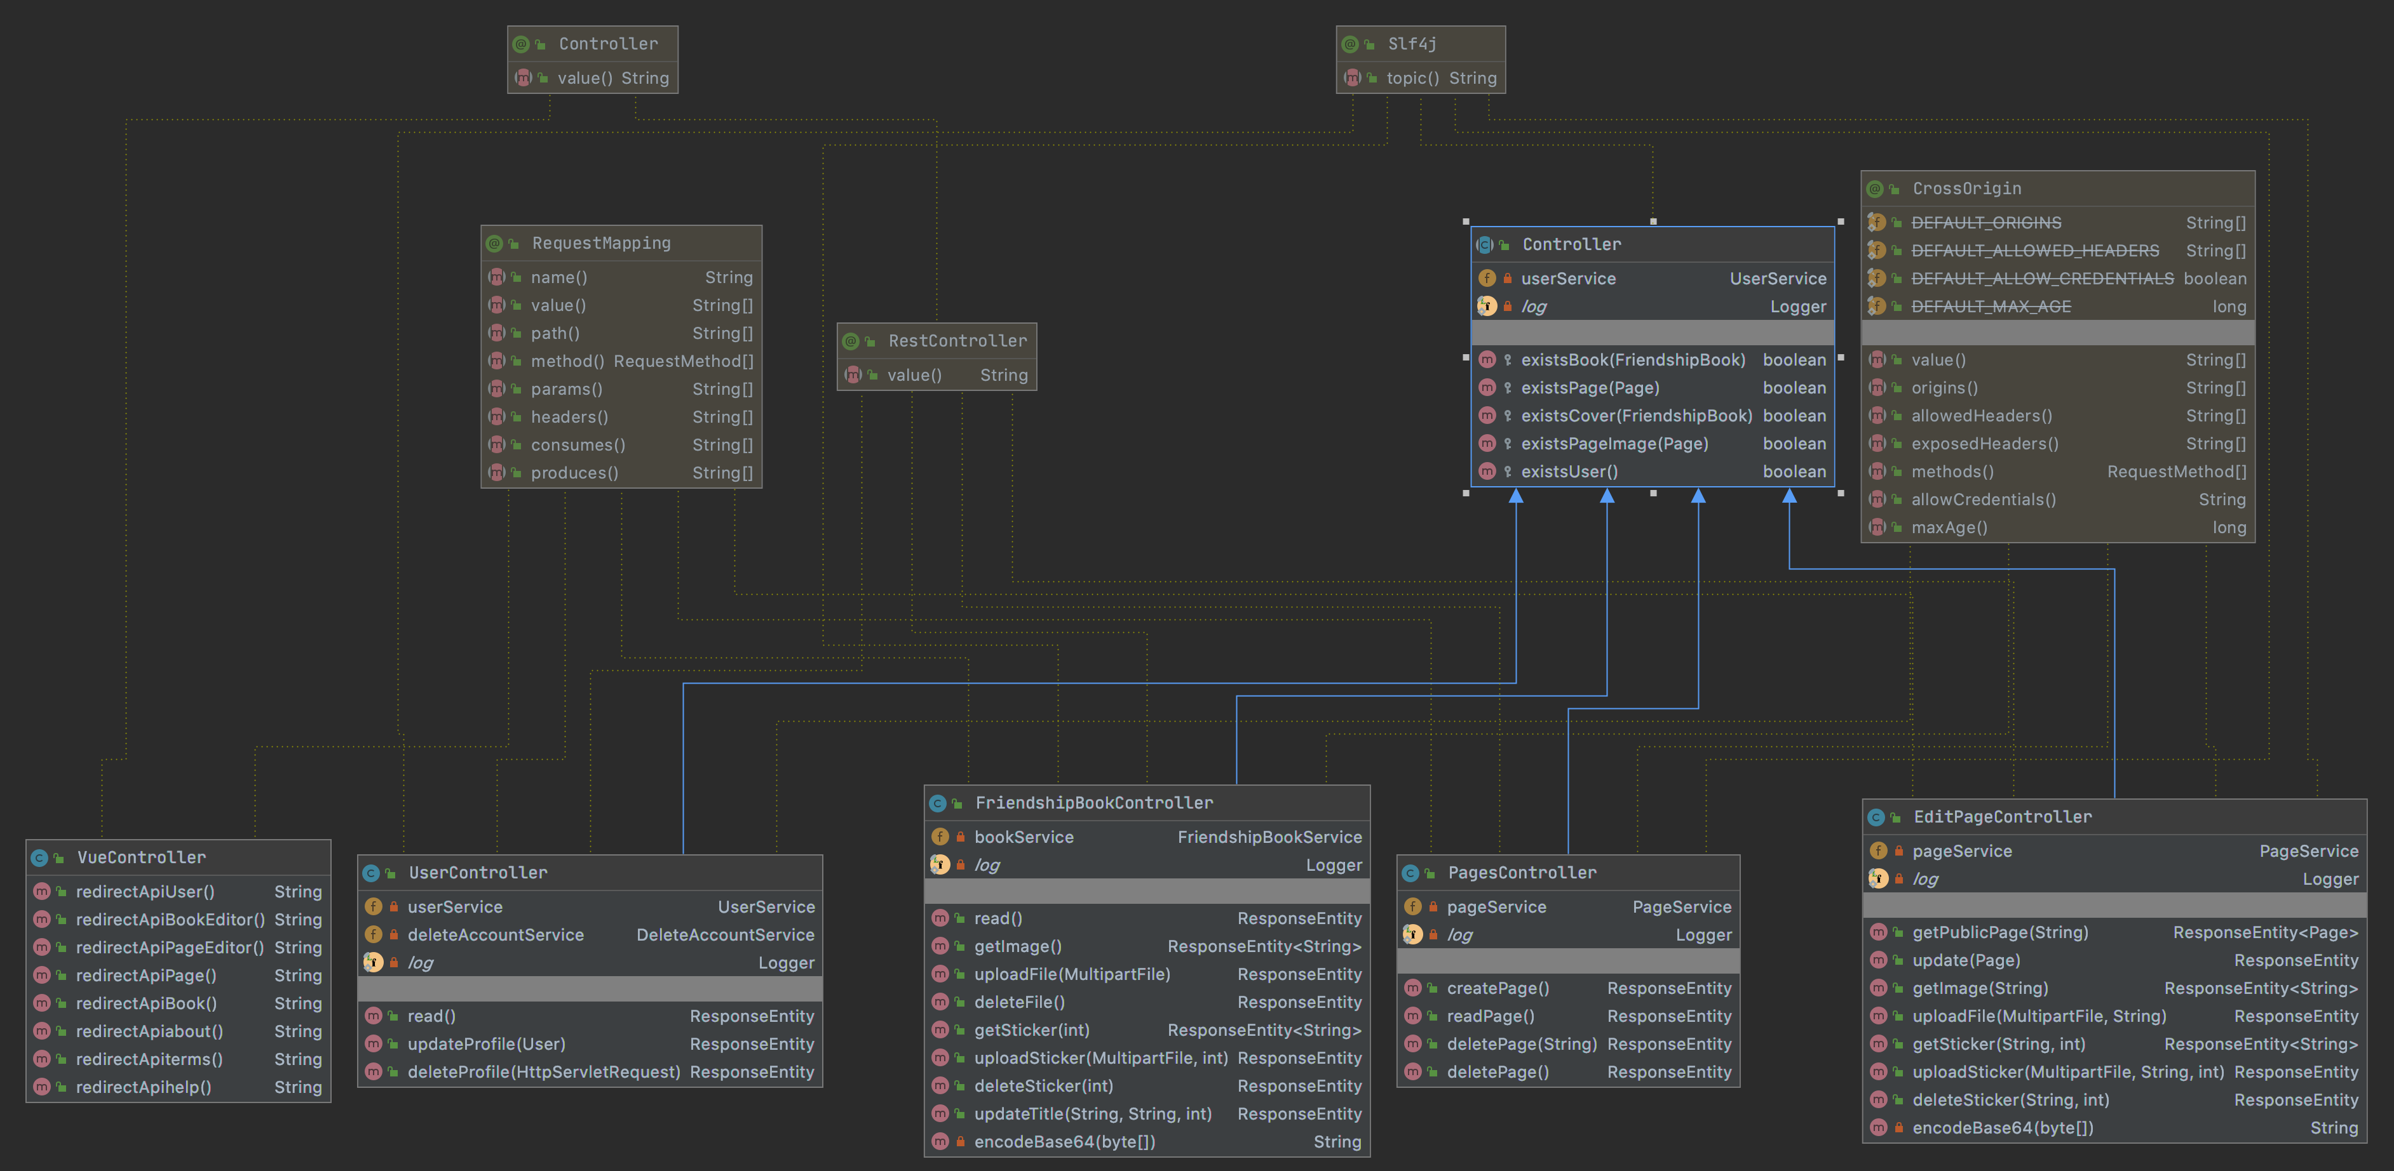
Class Diagram - Controller
Notes:
Jeanne: Our class diagram is very large and we will provide you a link on another slide. We will just show you some mainor parts of our app. This is an excerpt of our controllers. Every Controller is responsible for requesting a model by a user (or an anonymous user by requesting a public api)

Slide 27
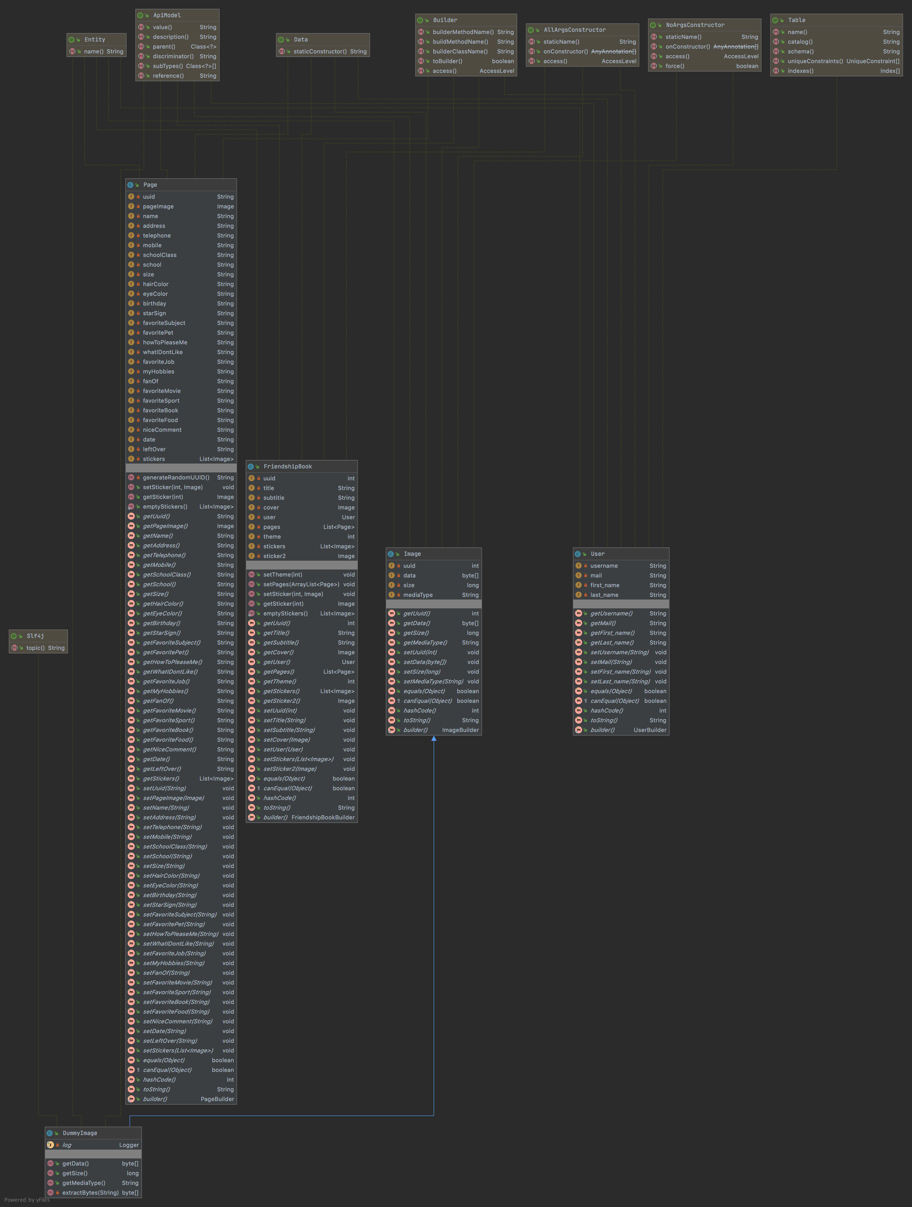
Class Diagram Model
►Whole view
Notes:
Jeanne: although we have a lots of services and controllers, the main dtos are clearly arranged. If you are interested into the whole view of the class diagram you can click on this link later on.

Slide 28
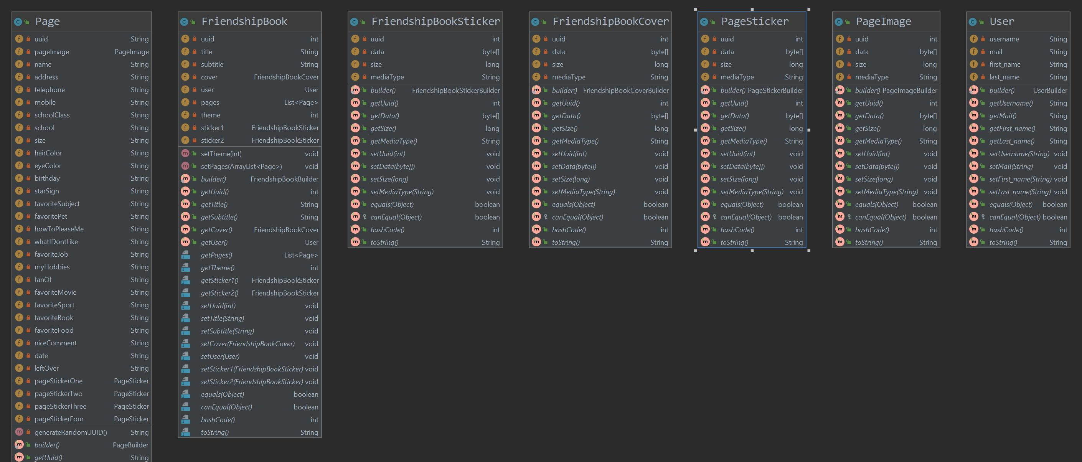
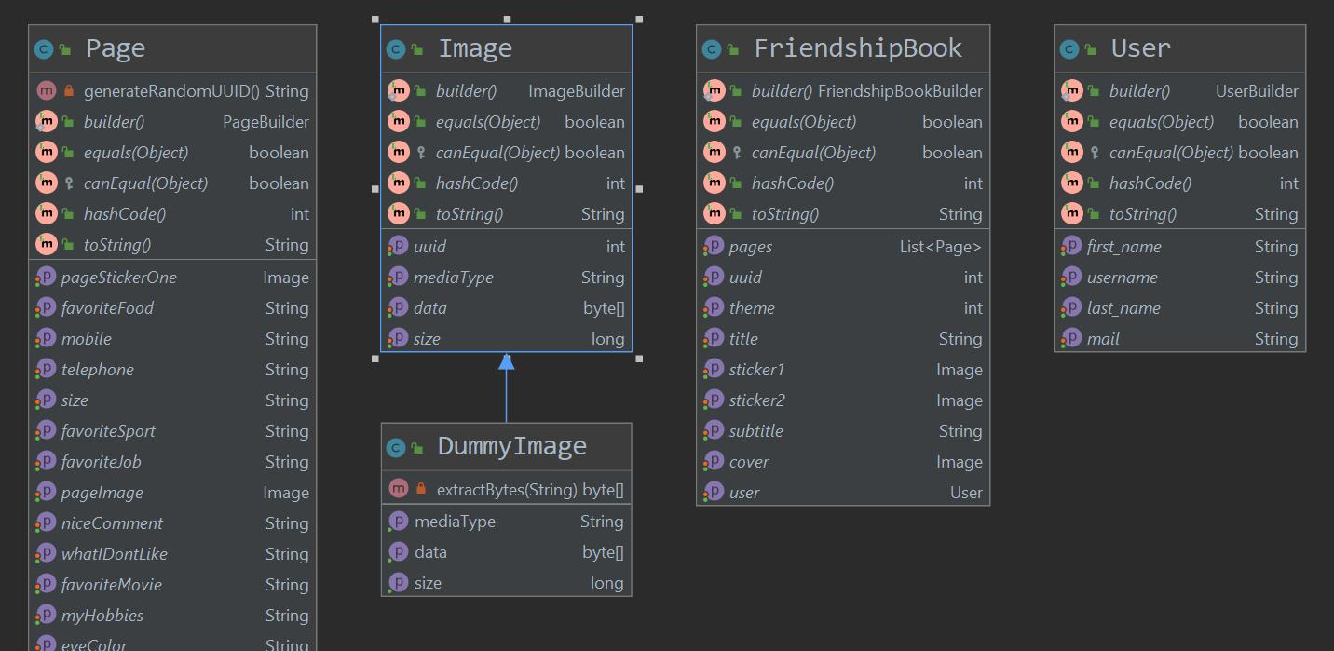
Design Patterns: Null Object
◀︎ before
After ▶︎
Notes:
Jeanne: before we applied any design pattern we had a lot more model classes as you can see on the upper left picture. We noticed that we have a lot of duplicated code by using different objects for stickers and images altough they have the same attributes. So we summed them up into one image object and applied the null object pattern for any not existing picture. This means we are not handling any explicit null reference on images but a dummy image. This, Dummy Image is inheriting from the original Image. Until a user has not explicity uploaded a picture or a sticker, the dummy image is a placeholder for any not defined image.

Slide 29
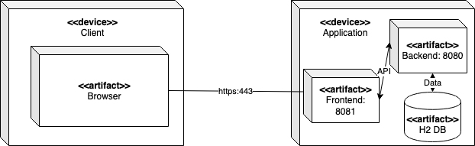
Architecture – Deployment View

Slide 30
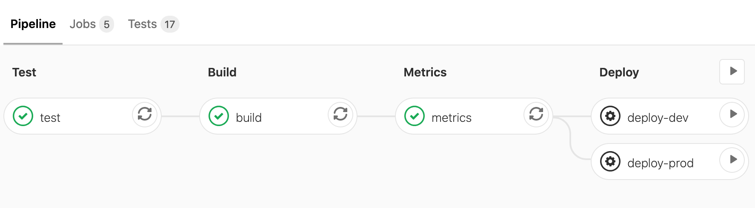
Continous Integration
Pipelines Test ► Build ► Metrics ► Deploy (automatic or manual)

Slide 31



Continous Integration
What | Code | Push to GitLab | Test Application | Metrics | Build Application | Deploy to Server
When | continously | Code is ready |  |  |  | + we decide
Where |  |  | ▼ ▼ | ▼ | ▼ | dev-system or stage-system
after
after
after
after
Notes:
Jeanne

Slide 32
QUality

Slide 33
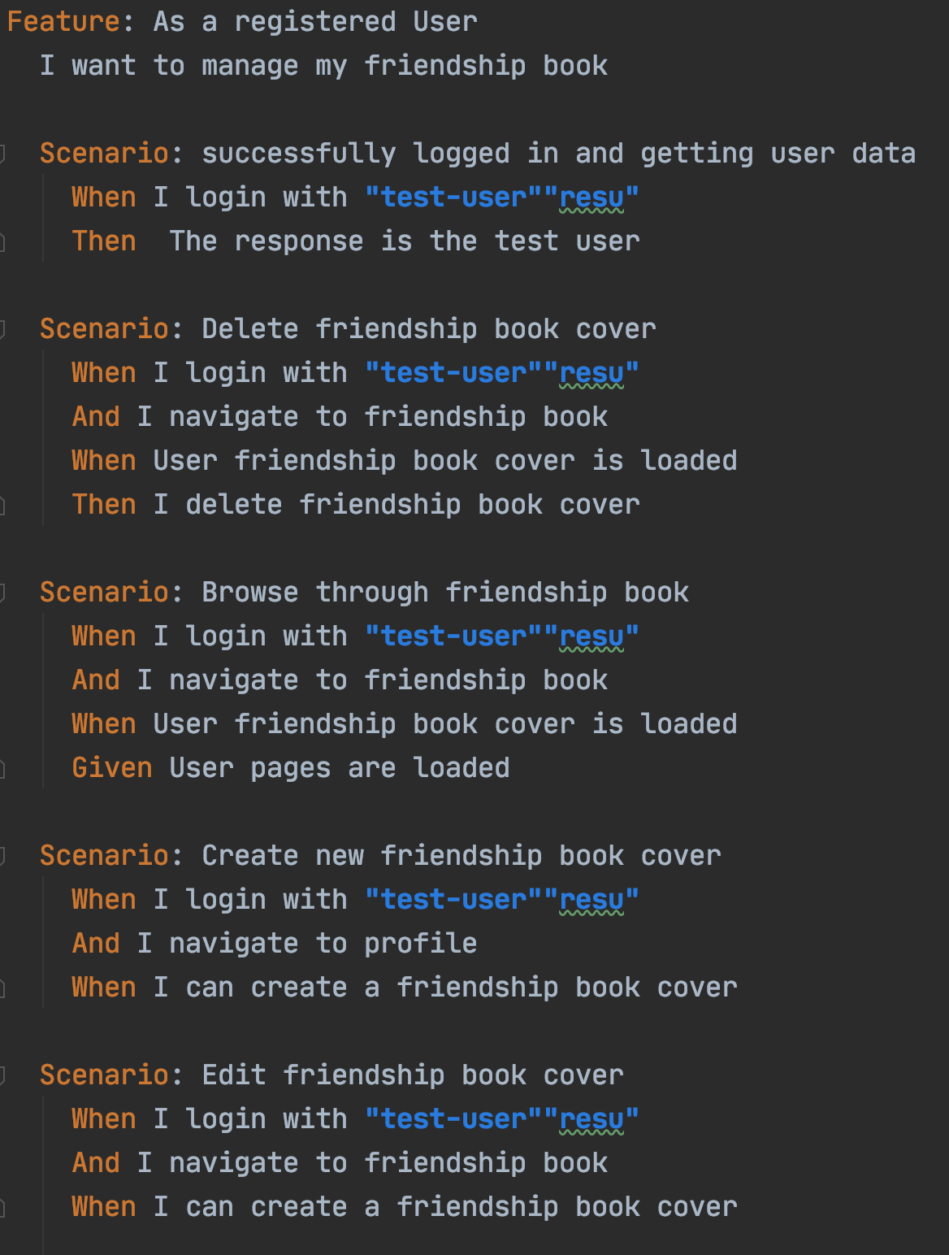

Testing
Automatic testing
Test results visible on GitLab per commit
BDD tests with cucumber
JUnit tests
Database tests
Field Test
Test Coverage
Notes:
Nico:
JUnit Tests: Service and Controller wurden getestet
Database Tests: Minor Service /Repo Tests
Behaviour Driven: Cucumber (Klicken -> Feature File Example)
Test Coverage: Jacoco berechnet das, mit Regex prozentzahl herausgefiltert und in Gitlab eingetragen. Sonarqube verwendet dieselbe Zahl
Field Tests: Erklären (Video + Google Umfrage) -> Schüler haben Pokemon-Zugangsdaten bekommen, Testen die Webseite anonym, Füllen die Umfrage aus. Es gibt eine Hilfsseite und ein Demovideo
KEINEN LINK ANKLICKEN

Slide 34
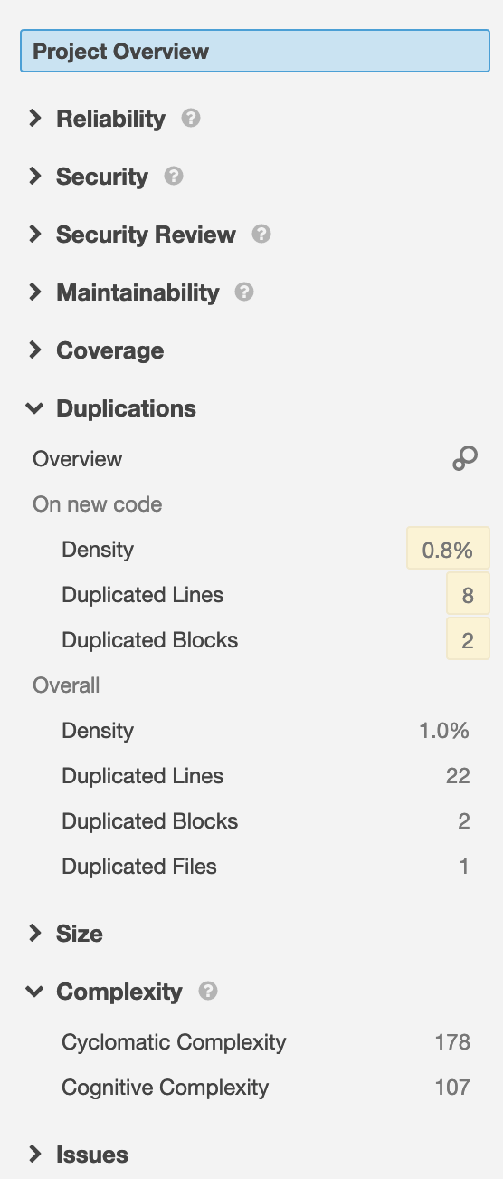
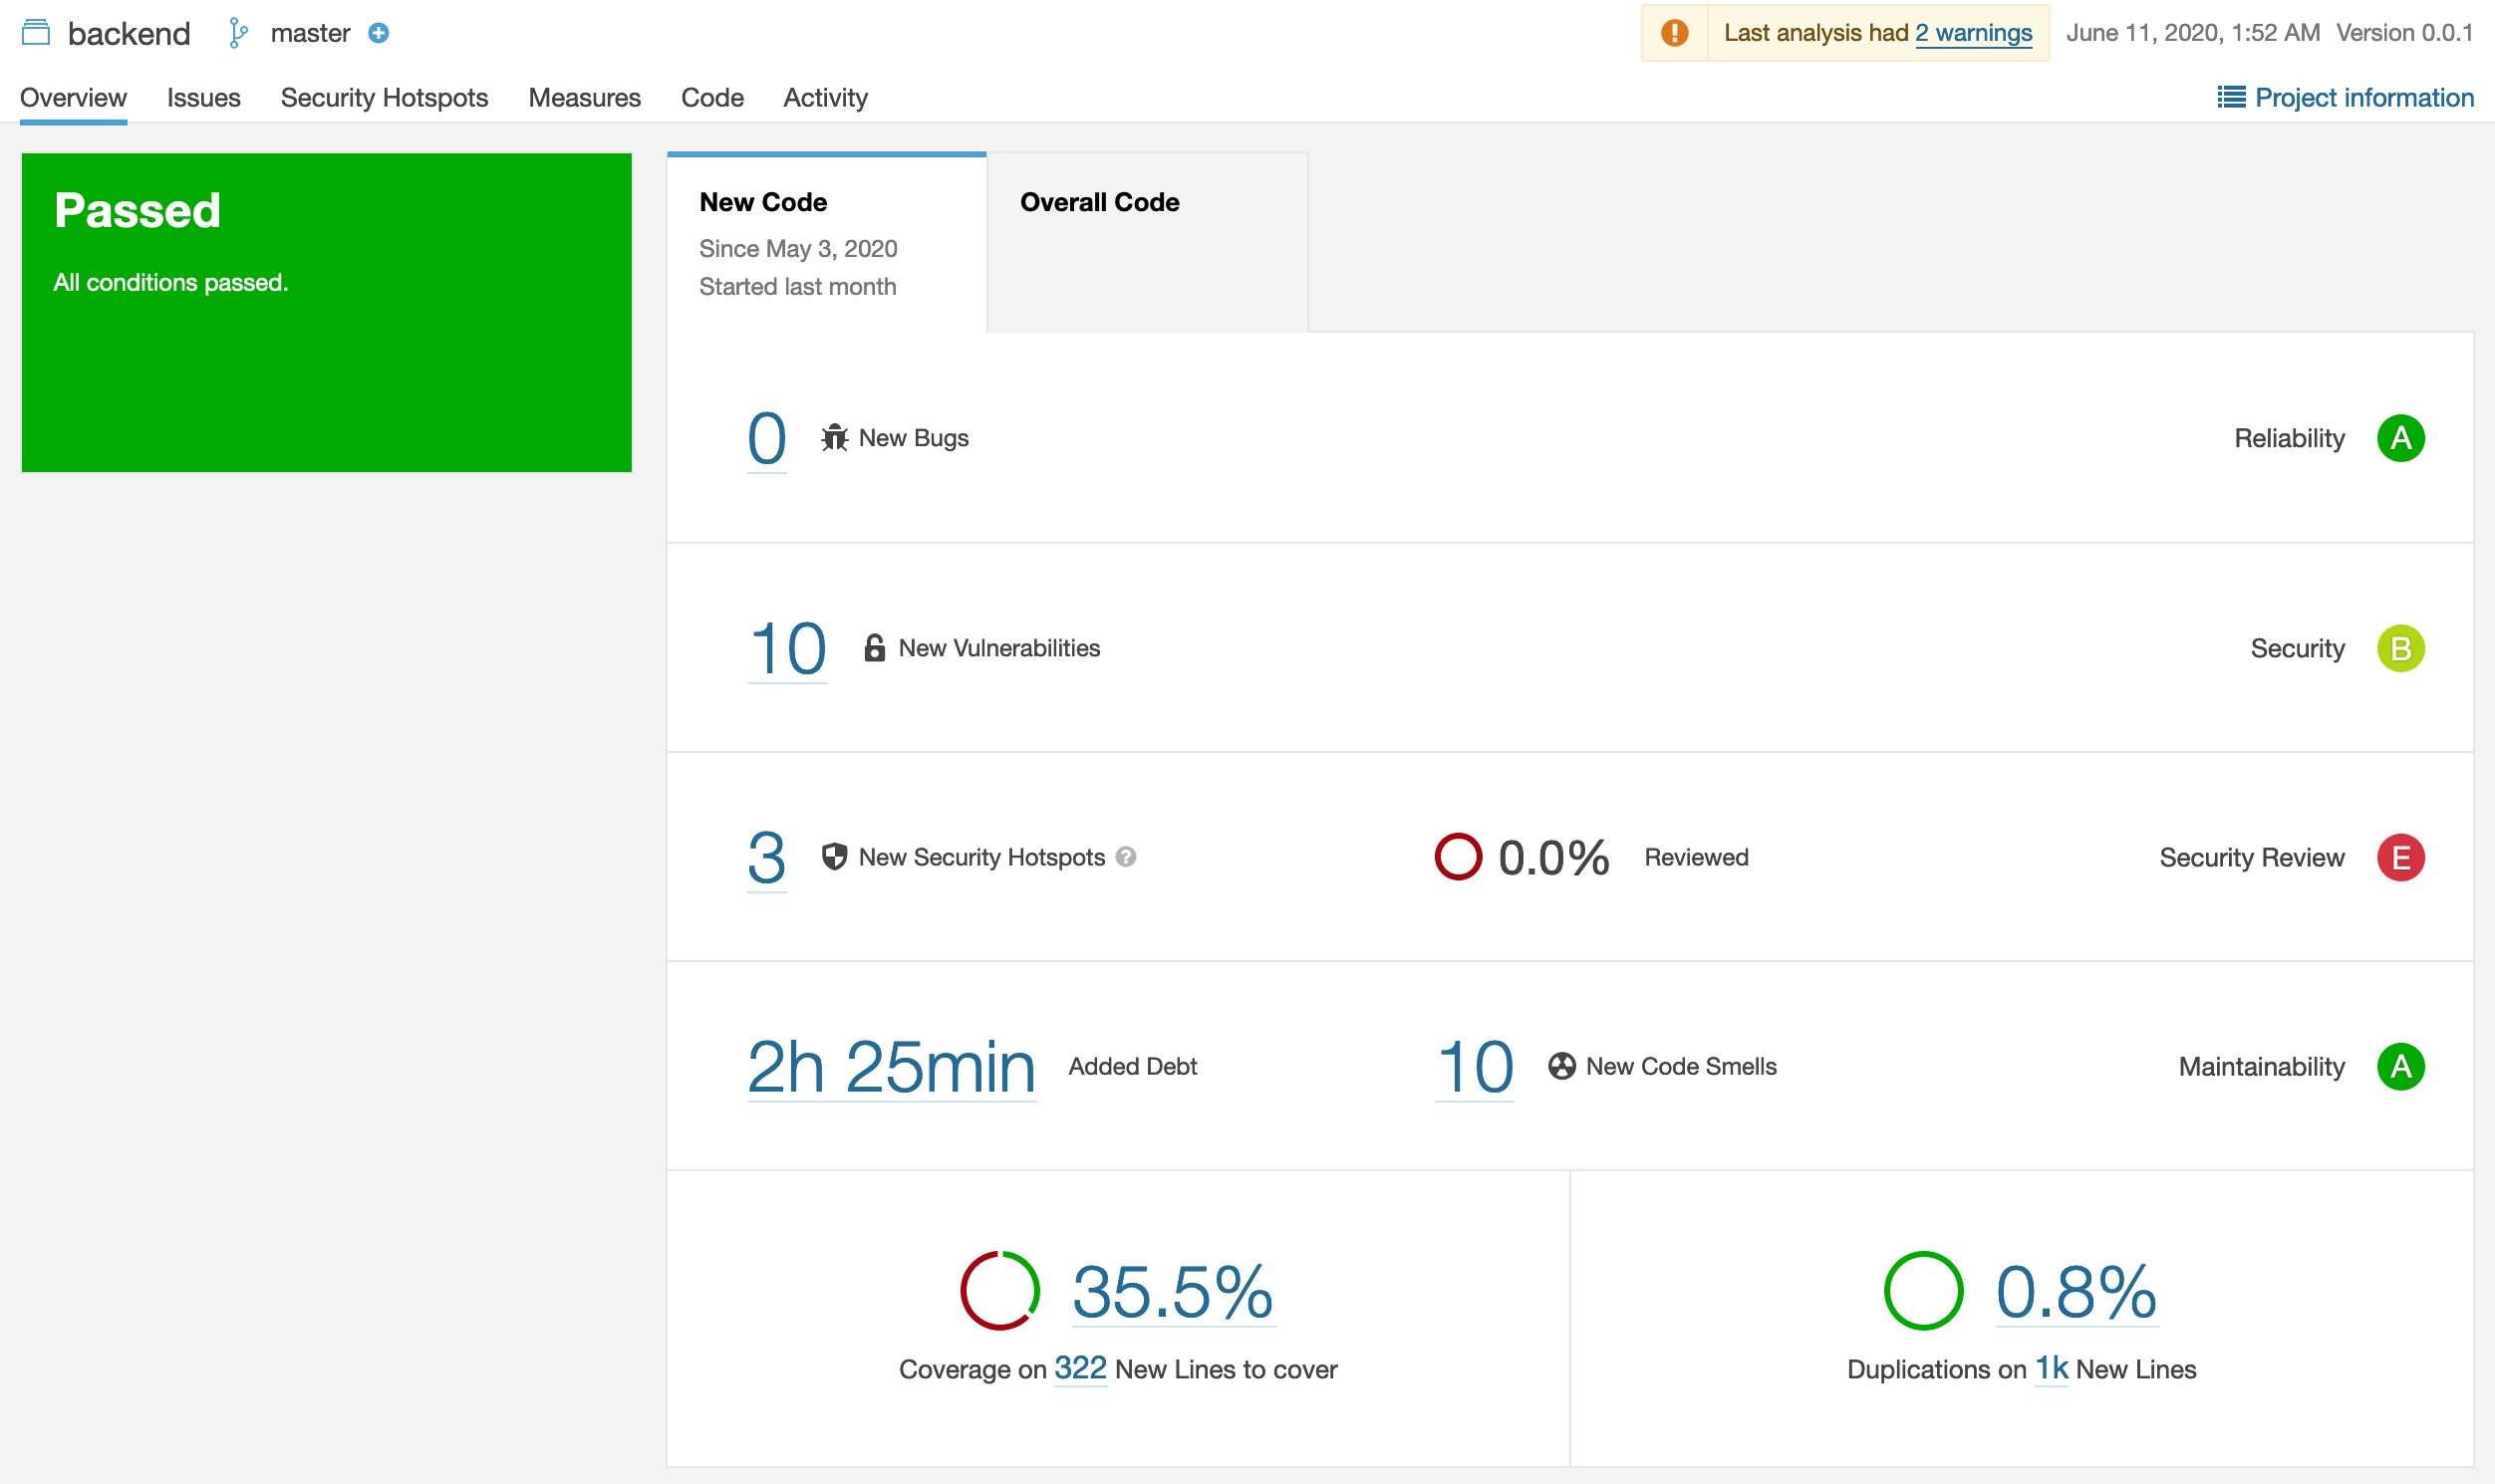
Metrics
▶︎Sonarqube
Notes:
Nico: Duplicated Lines (=Images und Sticker zu einem gemeinsamen Objekt zusammenfassen) und Cyclometic Complexity (=entfernen von If-Verschachtelungen)
Sonarqube läuft auf einem eigenen Server, aufrufbar unter folgendem Link NICHT DEN LINK ANKLICKEN; ENGLISCH REDEN

Slide 35
Further Questions?
Notes:
Nico

Slide 36
Bookly Documentation
Stage System
bookly.online
Documentation
SRS
SAD
Swagger
Testplan
Project Management and Quality
YouTrack
Blog
GitLab
SonarQube
Gantt Chart Time Estimation
Demo
Test Video
Notes:
Nico: Weitere Links

